Slide 1
WELCOME

Slide 2
VIDEO STREAMING
SUMBITTED BY –
1. Divya Manjarekar
UNDER GUIDANCE OF 2. Sanskruti Mane
POOJA MEHTA 3. Harshali Jadhav
4. Manasi Jadhav
5. Nisha Pardeshi
6. Ankita Kantale.

Slide 3
INTRODUCTION
Video streaming is a continuous transmission of video files from a server to a client. Video streaming enables users to view videos online without having to download them.
Streamed video content can include movies, TV shows, YouTube videos and livestreamed content. Services such as Netflix and Hulu have had great success in streaming videos to subscribers.

Slide 4
TECHNOLOGIES USED
Spring Boot
Postman
MySQL
Angular

Slide 5
REQUIRED SPECIFICATIONS
Hardware Configuration
Operating System: Windows 10
Hard Disk: 512 GB
RAM: 8GB
Software Configuration
Software IDE: Spring Tool Suite
Language: Java
Front End: Angular
Back End: MySQL ,Postman

Slide 6
SPRING ANNOTATIONS
@RestController :The @RestController annotation indicates that a particular class serves the role of a controller. Spring RestController annotation is typically used in combination with annotated handler methods based on the @RequestMapping annotation.
@Autowired: The @Autowired annotation provides more fine-grained control over where and how autowiring should be accomplished.
@RequestMapping : @RequestMapping is one of the most common annotation used in Spring Web applications. This annotation maps HTTP requests to handler methods of MVC and REST controllers.
@Entity:The Entity annotation specifies that the class is an entity and is mapped to a database table.

Slide 7
SPRING ANNOTATIONS
@Table: The Table annotation is used to create a table in database.
@PutMapping :@PutMapping is used for update the records.
@PostMapping: @PostMapping is used to create a resource Mapping.
@GetMapping: @GetMapping is used to read all the inserted records.
@DeleteMapping : @DeleteMapping is used to delete the records.
@PathVariable: The Path Variable annotation is used to extract the value from the URL.
@RequestParam: @RequestParam annotation is used to read the form data and bind it automatically to the parameter present in the provided method.

Slide 8
SPRING ANNOTATIONS
@Request Body: The @RequestBody annotation is applicable to handler methods of spring controller. spring should deserialize a request body into an object.
@OneToMany Mapping:OneTo-Many relationship between table A and table B indicates that one row in a table A link to many rows in table B.but one row in table B links to only one row in table A.

Slide 9
SPRING ANNOTATIONS
@ExceptionHandler:The @ExceptionHandler is an annotation used to handle the specific exceptions and sending the custom responses to the client.
@ControllerAdvice: A controller advice allows you to use exactly the same exception handling techniques but apply them across the whole application, not just to an individual controller. You can think of them as an annotation driven interceptor.
Handles Resource Not Found Exception.

Slide 10
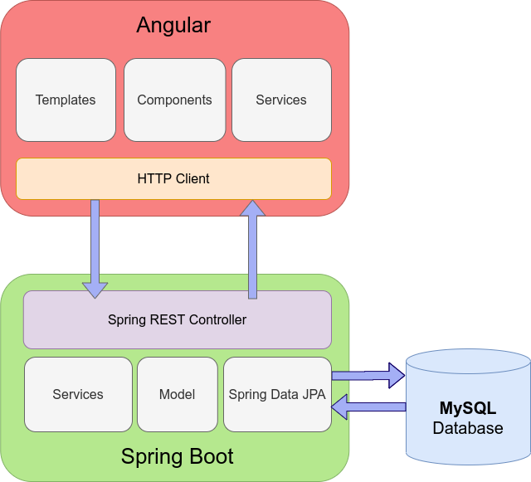
SYSTEM FLOW DIAGRAM

Slide 11
MODULES
The system contains 5 Modules
ADMIN – Registration by Postman, Login, Upload Video, List Video, HomePage, View Video
USER – Registration, Login, WishList Video, List Video, HomePage, View Video
WISHLIST – User can make its own Play List
CATEGORY – As Enum
VIDEO – Access by Admin and User.

Slide 12
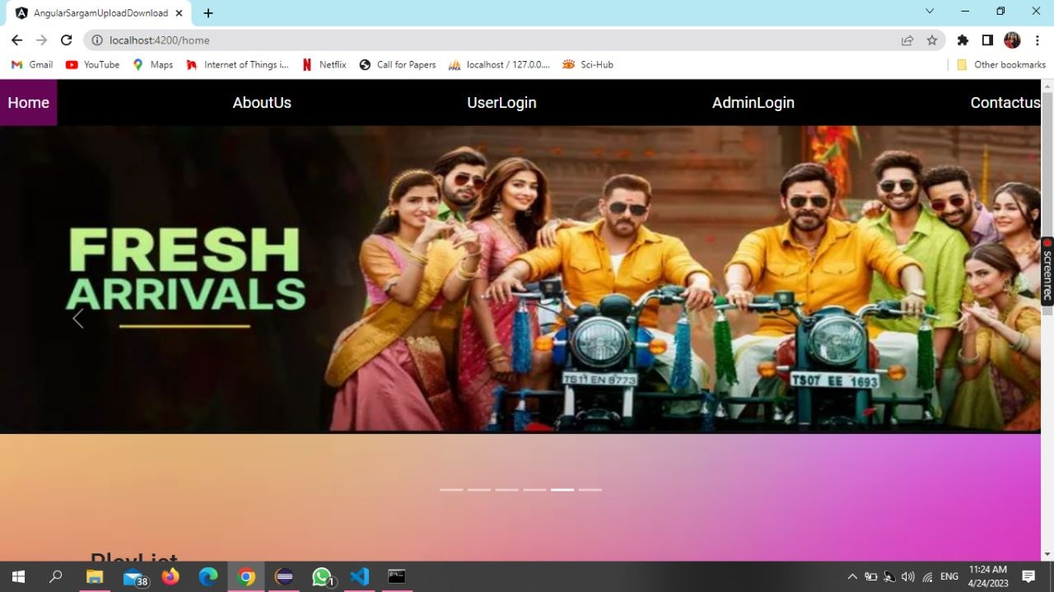

Slide 13
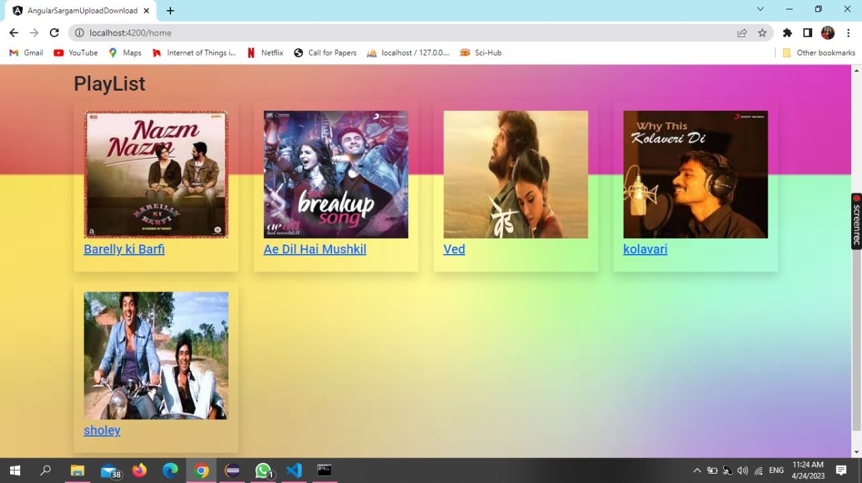

Slide 14
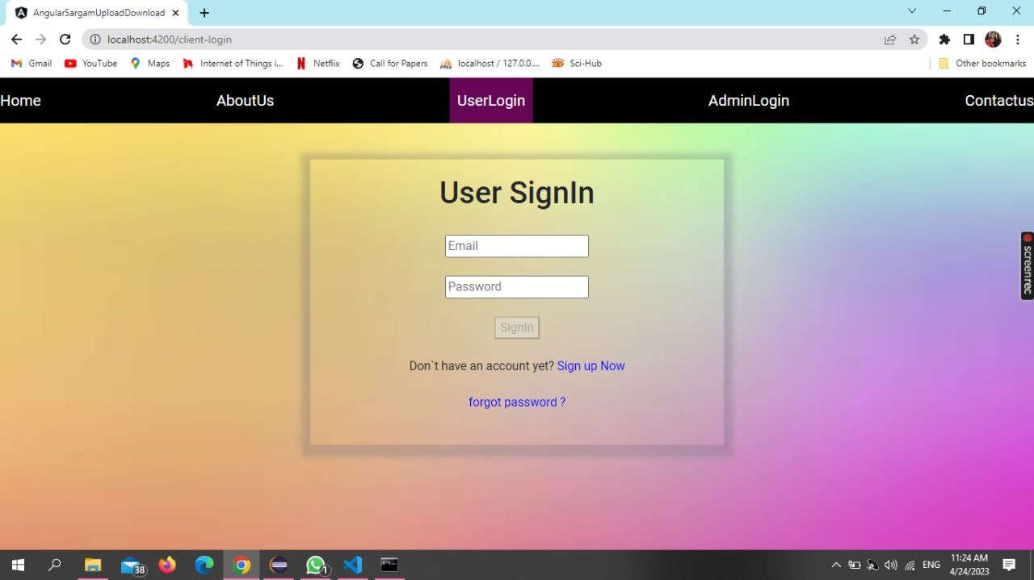

Slide 16
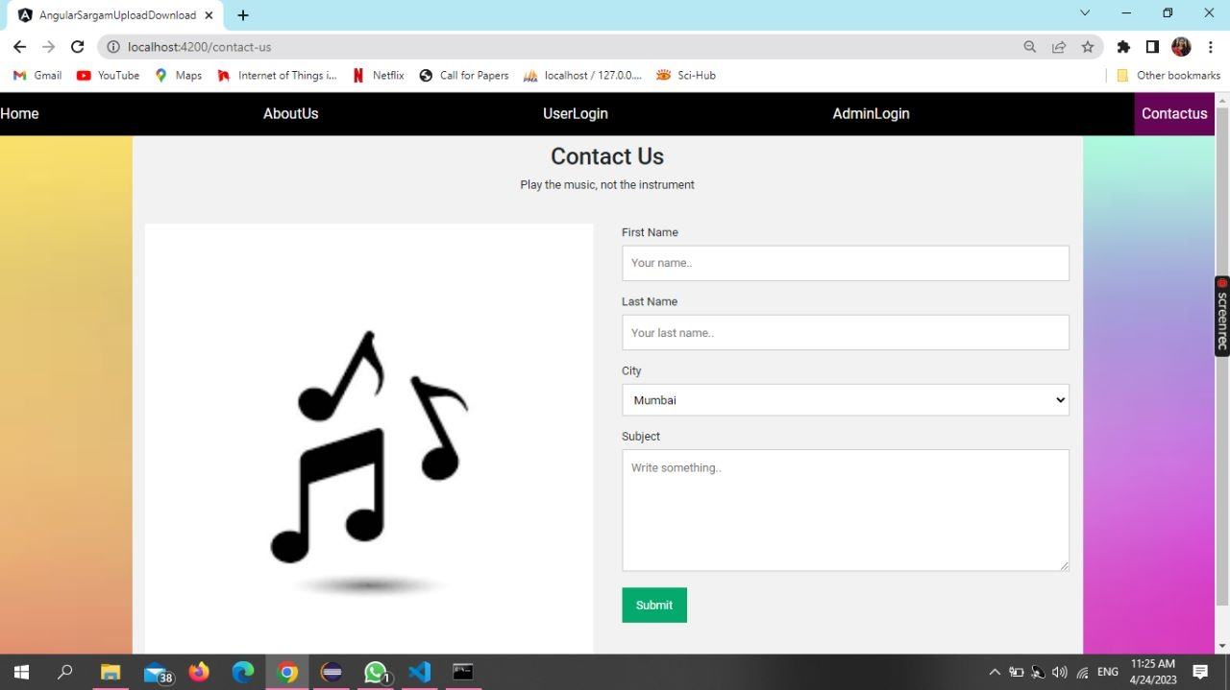

Slide 17
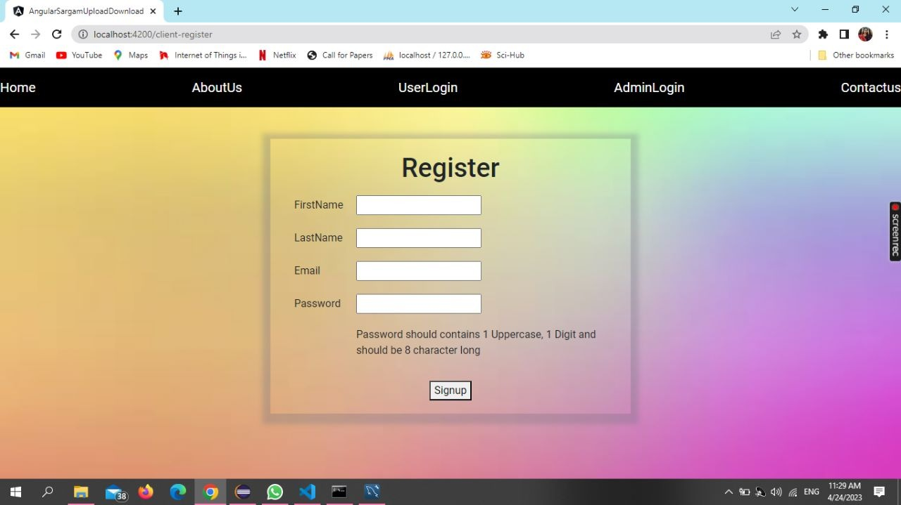

Slide 18
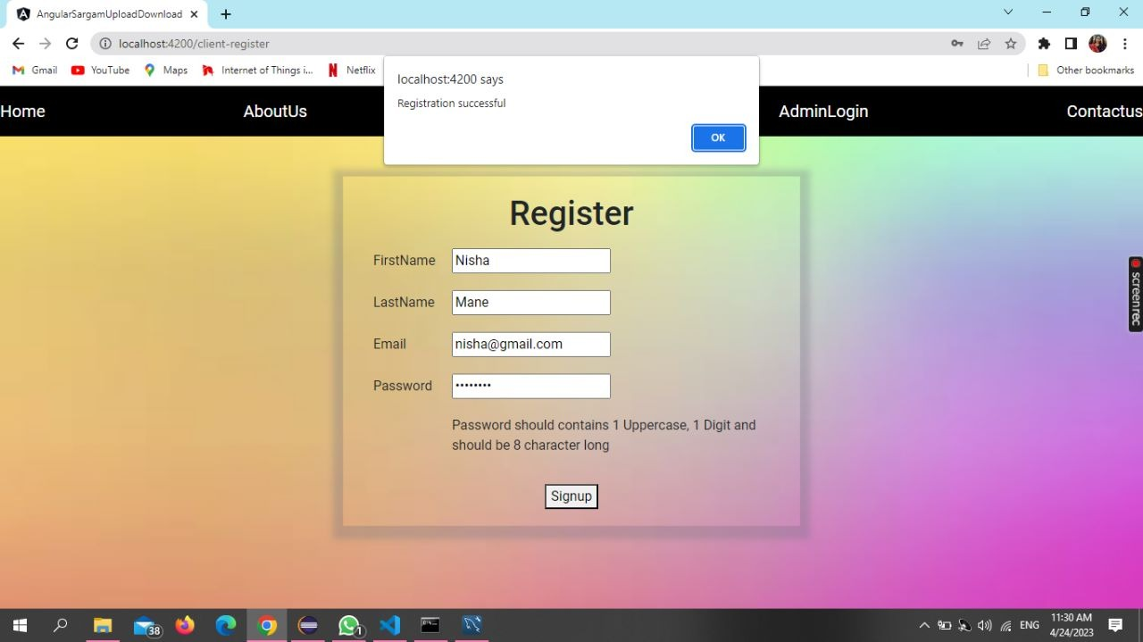

Slide 19
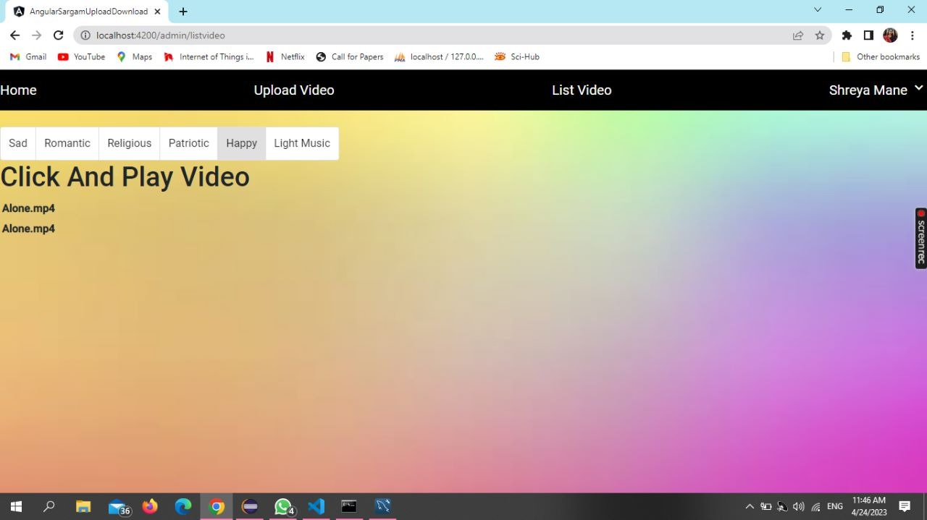

Slide 20
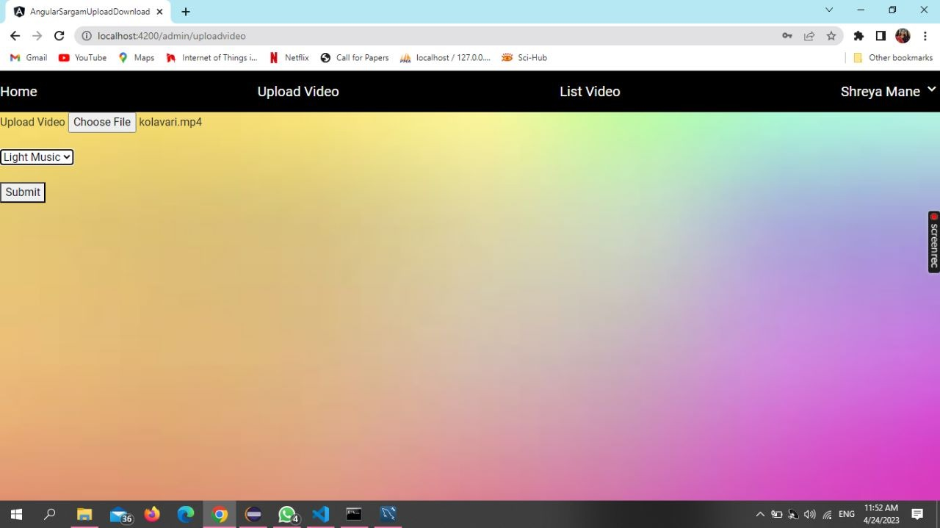

Slide 21
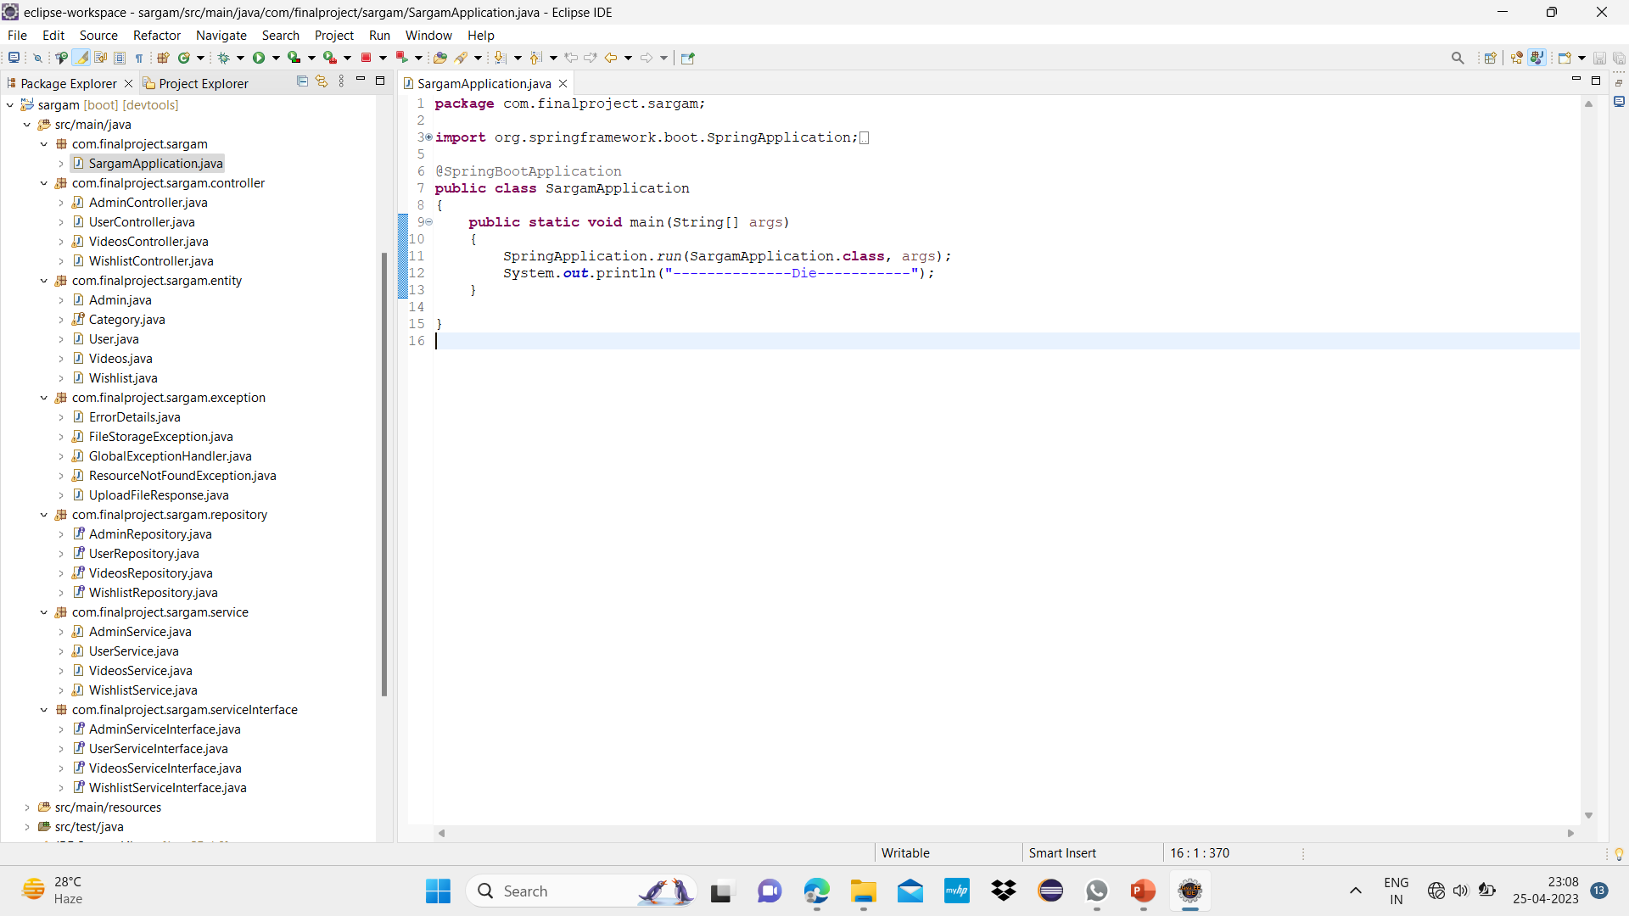

Slide 22
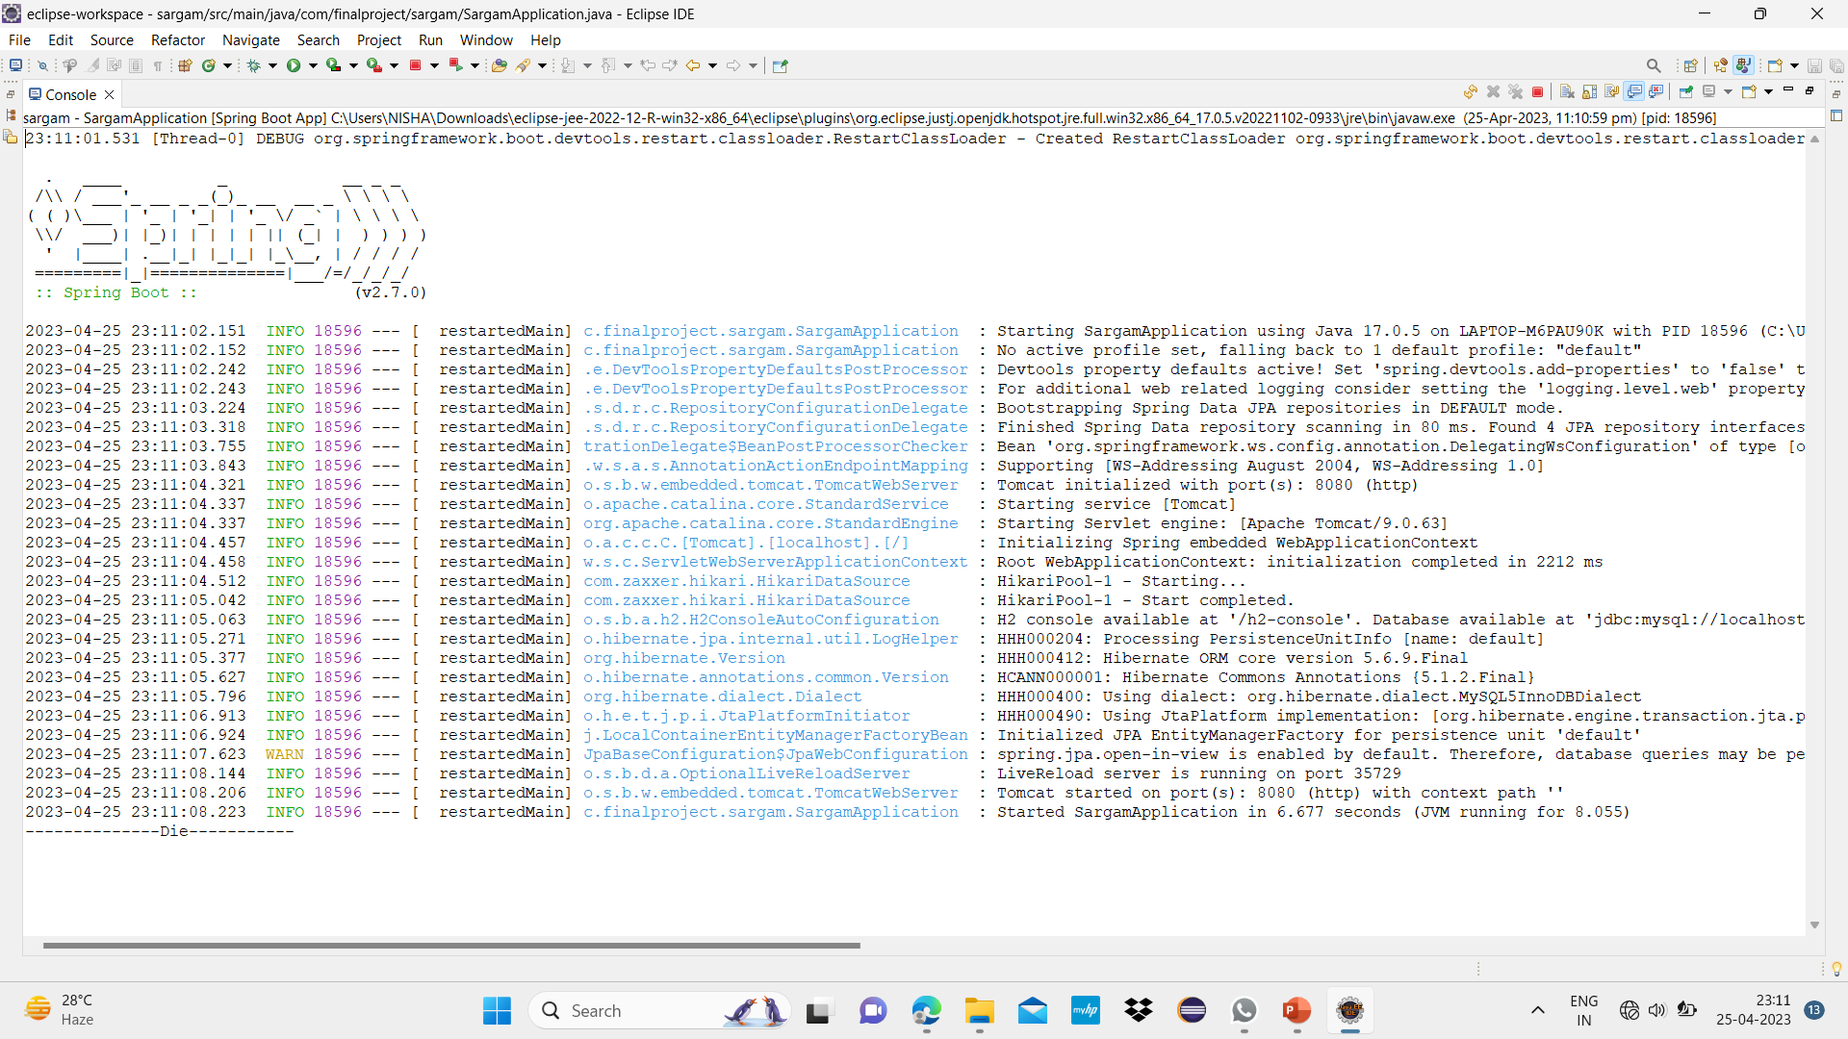

Slide 23
ADVANTAGES
Instant Playback.
More Convenient to Reach Maximum Audience.
Access with Proper Formatting to a Myriad of Content.
Provides the Best Quality Content.
Supports a Wide Range of Devices.

Slide 24
CONCLUSION
streaming video and audio will play a bigger role in delivering course materials to online user.
Framework for Simultaneously streaming video from multiple senders to a single receiver.
This form of technology brings live videos too users for entertaining purpose.

Slide 25
THANK YOU.

